Slide 1
Powershell and bypassing constrained language mode
Taz larose

Slide 2
Powershell language modes
PowerShell.exe comes with several LanguageModes (e.g. Full Language [desirable], Restricted, No Language, and Constrained Language).
The Constrained Language Mode can be enabled to limit the types of commands that can be executed within a PS session.
For example, CLM will block COM objects, Unapproved .NET types, XAML based workflows, and PowerShell classes.
This prevents the use of red team PS tools such as PowerSploit modules (e.g. Recon[AD Enumeration], PowerUp.ps1, Exfiltration, etc.).

Slide 3
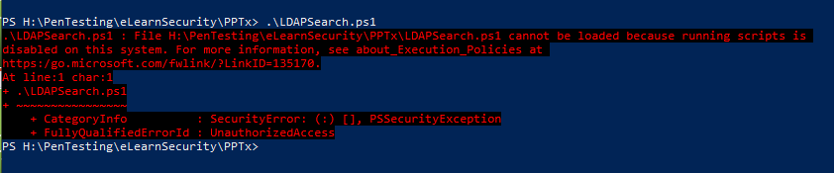

Slide 4
Downsides to clm
Constrained Language Mode can improve security but isn't designed to be used standalone.
Can be bypassed.
Can break existing PowerShell scripts.

Slide 5
Better way to utilize CLM
In conjunction with Device Guard's User Mode Code Integrity (UCMI)
UCMI is a tool allowing admins to set policies describing the code that is allowed to run on the system.
Windows Defender Application Control (WDAC) Script Enforcement
Unsigned PowerShell scripts and interactive PowerShell are restricted to Constrained Language Mode
NOTE: only supported on Windows 10 (version 1903) and higher.

Slide 6
Reasons to use powershell without powershell.exe
Bypass CLM (standalone) and obtain FullLanguage Mode.
Can be more difficult to detect malicious activity.
…and it's cool.

Slide 7
ID the language mode
Once you have access to PowerShell on a system, you can ID the LanguageMode by running the following PS command:
$ExecutionContext.SessionState.LanguageMode
Noisy way is to attempt running a script and reading the error output.

Slide 8
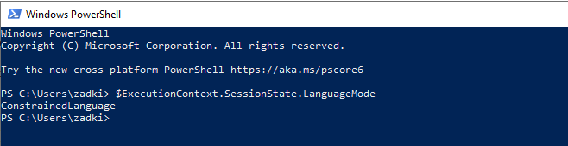

Slide 9
Running powershdll.dll
NOTE: Doesn't require access to PowerShell.exe, uses powershell automation dll’s.
From shell or Command Prompt there are multiple methods for running:
rundll32.exe, installutil.exe, regsvcs.exe, regasm.exe, regsvr32.exe

Slide 10
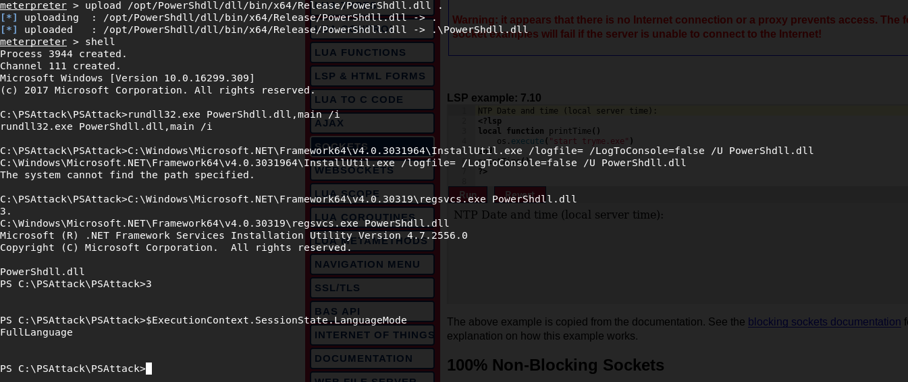

Slide 11
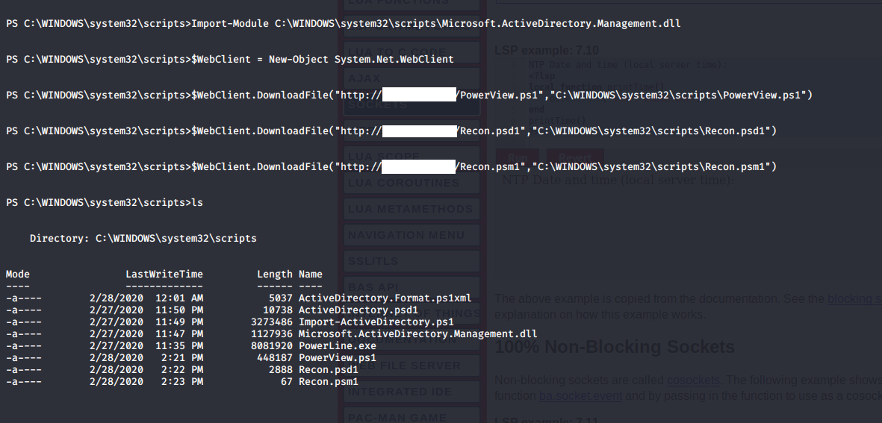

Slide 12
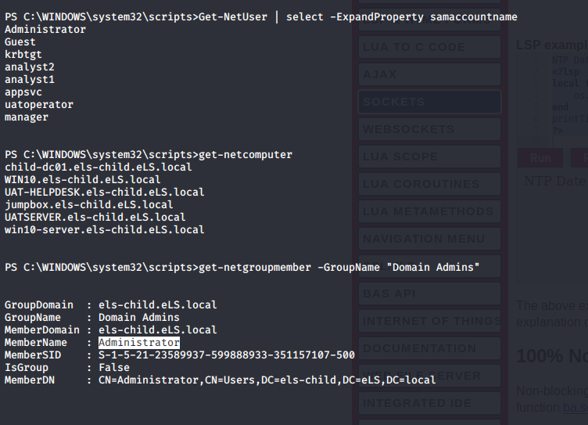

Slide 13
Downside of powershdll.dll
Writes to filesystem.
Is detected by many AV’s.
The interactive console has a low number of maximum characters you can enter.
Very long encoded commands or PS reverse shell “one-liner” isn’t possible.
Not very convenient to use.

Slide 14
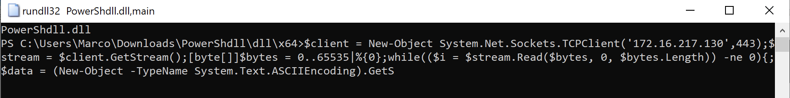

Slide 15
Alternatives of powershdll.dll
There are other methods for using PowerShell without PowerShell.exe
PowerLine, NPS (Not PowerShell), PowerLessShell, Nopowershell, and SyncAppvPublishingServer for example.
Reference: (https://medium.com/@Bank_Security/how-to-running-powershell-commands-without-powershell-exe-a6a19595f628)

Slide 16
Detection methods
PowerShdll.dll file signature detection.
Can look for the invocation of the System.Management.Automation.dll
most EDR solutions should be able to provide a detection capability for this.
Analyze the host locally, viewing the threads and dll’s invoked by rundll32 or the others listed (i.e. installutil, regsvcs, regasm, and regsvr32).
resource: https://inquest.net/blog/2020/02/25/Hiding-In-Plain-Sight

Slide 18
Questions??
Thank you.

